Slide 1
Innovation, capabilities and incentives Mark Dutz “Strengthening innovation for productivity growth in Brazil” seminar Brasilia, July 1, 2015

Slide 2
OUTLINE: Making policies for innovation work
Innovation
Catch-up & Frontier
Catch-up critical for aggregate productivity growth
Capabilities
Business investments in Knowledge Capital
Management capabilities critical for innovation
Incentives
For businesses: Competition
For government:
‘Competition-friendly’ policy support
M&E + PER

Slide 3
I.1 A broad interpretation of innovation
Innovation = ‘new’ technology + entrepreneurship
Hard + soft technologies:
products, processes, managerial, organizational, marketing & collaboration assets
2 types of innovation
Frontier (new-to-world, radical)
Catch-up (new-to-the-firm, incremental)
Successful, growing businesses are largely based on:
Technology adoption
Dynamism of entrepreneurs/intrapreneurs

Slide 4
I.1 Innovation is how low-productivity firms “catch up” to higher-productivity firms
What does “large productivity differences” mean?
Average 90-10 percentile TFP ratio within 4-digit manufacturing industries in US is about 2-to-1
This means that the 90th percentile producer obtains twice as much output from the same measured inputs (capital, labor, energy, materials) as the 10th percentile producer
China: 3-to-1 ratio
India: 5-to-1 ratio

Slide 5
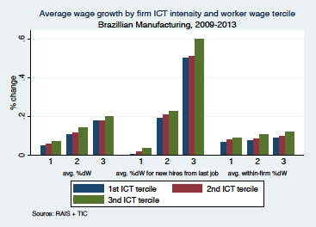
I.1 Catch-up innovation can spur better wages and jobs
Innovative (ICT-adopting) firms give higher wage increases across wage terciles
Input market flexibility: wage increases for new hires drives average w increases
Source: Dutz, Mation, O'Connell and Willig (2015)

Slide 6
I.2 Innovation is critical for overall productivity growth 3-way productivity typology
cross-industry structural change
reallocation of resources between industries
from some activities to others
within-industry structural change
reallocation of resources across enterprises within industries
from contracting/exiting to entering/expanding firms
within-firm structural change
resource reallocation, investment & innovation alters structure & efficiency of each firm
linked to new-to-firm technology adoption + shifts to higher-productivity product lines

Slide 7
I.2 Innovation of largest plants spurs “manufacturing miracle”
India growth accounting: Averages of annual plant growth rates over 2 periods (%)
Source: Bollard, Klenow and Sharma (2013)

Slide 8
I.2 Faster jobs growth over life-cycle driven by innovation
Differences in w/i firm TFP, as US “transformational entrepreneurs” grow and invest in intangible K, account for about 25% of gap in aggregate TFP b/w rich and poor countries
Source: Hsieh and Klenow (2014)

Slide 9
I.2 Catch-up innovation by incumbents key for growth
How much aggregate growth occurs thru different innovation channels?
Most growth (about 90%) comes from incumbents, not entrants
Most growth (about 90%) comes from quality improvements, not brand new varieties
Own-product quality improvements by incumbents are about 2x more important than creative destruction
US manufacturing census data from 1963 to 2002
Quantification of dynamics of entry, exit and survivor growth of plants
Decomposition of sources of TFP growth in contributions from different types of innovation
Source: Garcia-Macia, Hsieh and Klenow (2015)

Slide 10
II.1 Building capabilities: thru investments in knowledge K
(1) digital K (computerized information): software and databases
(2) intellectual K (innovative property): R&D, creative assets, architectural, engineering & other designs, mineral exploration & evaluation
(3) human-organizational K (business competencies):
- managerial & worker K: skills upgrading thru training
- marketing K: market research, branding and advertising
- organization K: business process/organizational improvements + new business models
- collaboration K:
- network building (to learn from clusters/subcontracting/global value chains)
- other spending that spurs joint learning from global knowledge

Slide 11
II.1 Investments in knowledge K go far beyond just R&D
Knowledge K as % of expanded GDP, 2006 – for whole economy (India) and for market sector (others)
Source: Hulten and Hao (2012), Dutz et al. (2012b), Hulten, Hao and Jaeger (2012)

Slide 12
II.1 Knowledge K larger than physical K for US, UK, Sweden
US Business Investment, 1972-2011 (% of adjusted GDP)
Business Investment, 2011 (% of VA)
Source: Corrado and Hulten (2010, updated)
Source: OECD (2013)
US: Knowledge K rising almost continuously for 40 years; 15% of VA in 2011
UK: Knowledge K 34% higher than physical K in 2009

Slide 13
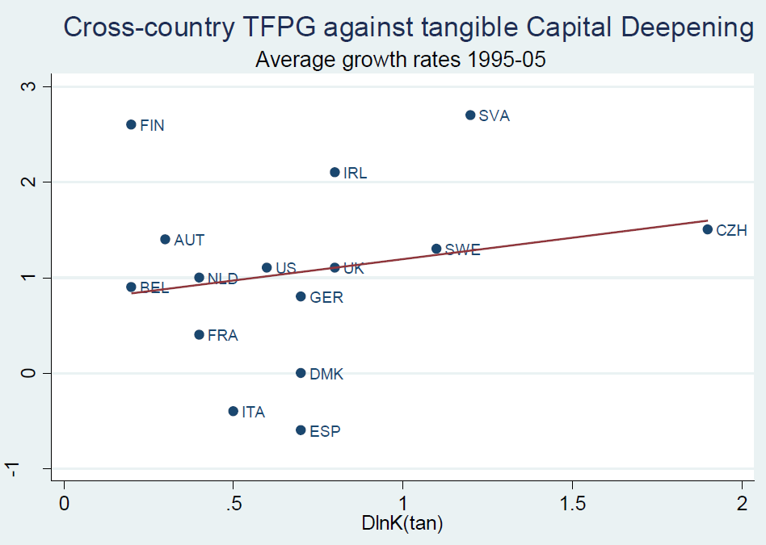
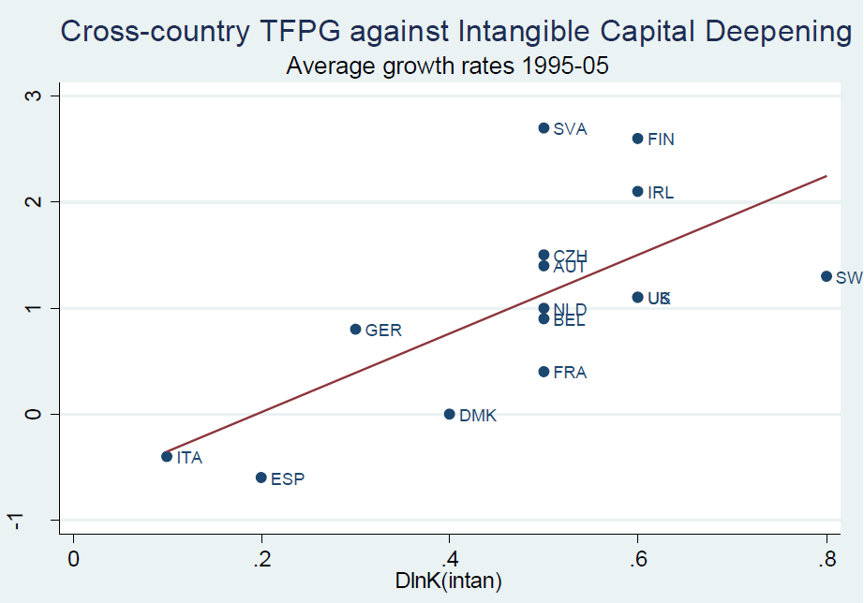
II.1 Investments in knowledge K are a key correlate of innovation
Source: Corrado et al. (2012)
Stronger correlation between TFP growth & knolwedge K (than for physical K)

Slide 14
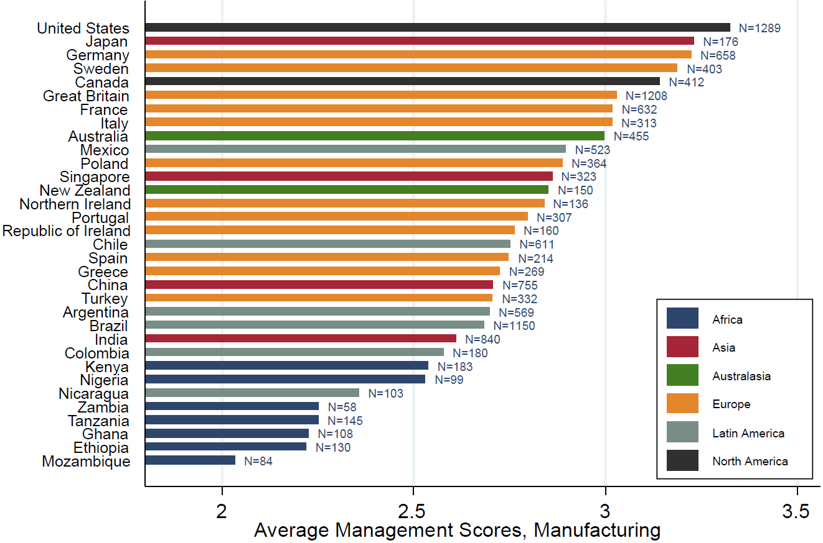
II.2 Management capabilities across countries
Source: Bloom, Lemos, Sadun, Scur and Van Reenen (2014)

Slide 15
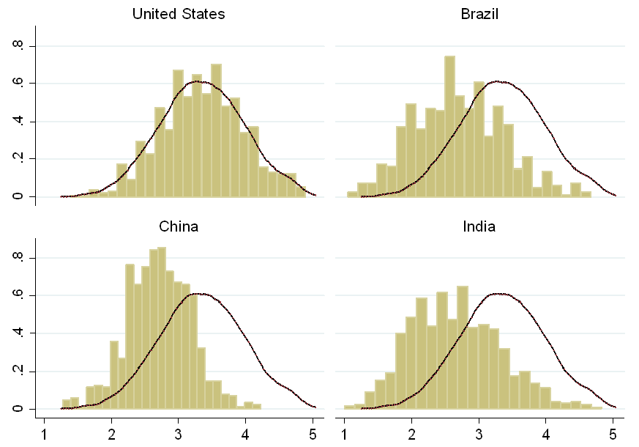
II.2 Management capabilities across firms
Source: Bloom, Lemos, Sadun, Scur and Van Reenen (2014)

Slide 16
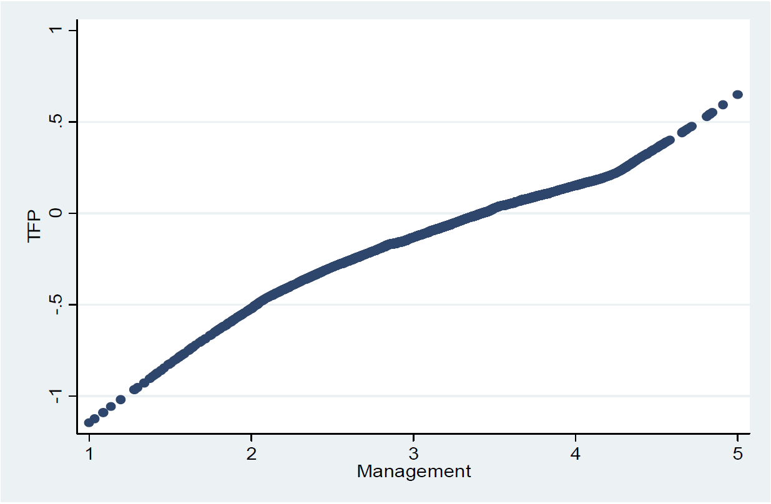
II.2 Management is correlated with innovation (TFP)
Source: Bloom, Lemos, Sadun, Scur and Van Reenen (2014)

Slide 17
II.2 Does management have a causal impact on innovation?
2 randomized trials suggest YES
training policy can spur innovation
But other interventions yield inconclusive results
India: large textile firms (Bloom et al. 2013)
20 large experimental plants around Mumbai
intervention on specific management practices by international firm
TFP increased 17%, output 9%, and profits by $325k per plant in 1st year
opening of more production plants within 3 years
Mexico: heterogeneous SMEs (Bruhn et al. 2013)
80 enterprises taking up consulting services across industries in Puebla
intervention on wide range of managerial skills by mixed set of local firms
positive effects on TFP, Returns on Assets and “entrepreneurial spirit” in 1st year
large increase in employment & earnings within 2-3 years

Slide 18
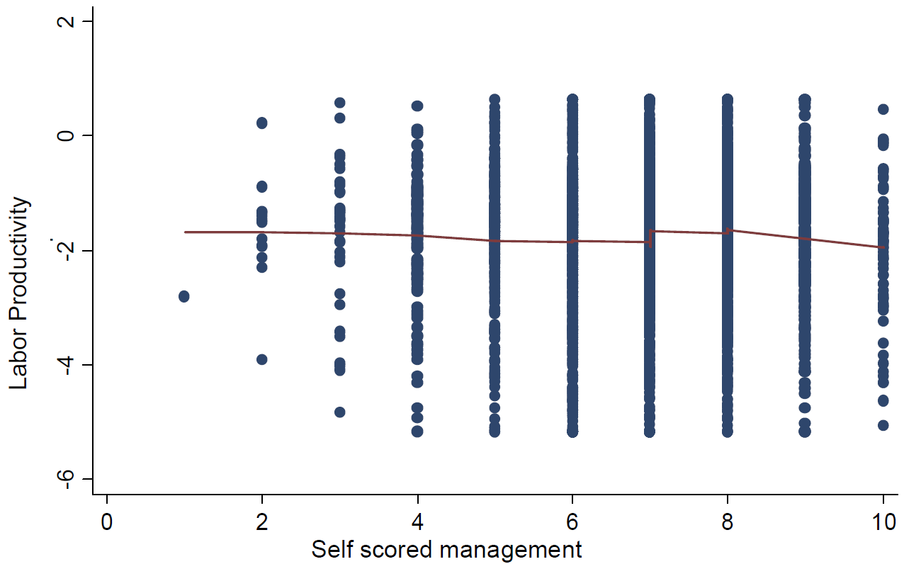
II.2 But poorly managed firms don’t know it!
Source: Bloom, Lemos, Sadun, Scur and Van Reenen (2014)

Slide 19
III.1 Competition incentives: in markets & thru regulations
Why does competition matter for innovation?
Ever-changing global markets mean global best-practice efficiency is a moving target
Lack of competition dulls incentives to keep up with global target
Market competition and regulations (that mimic competition) can spur innovation thru 2 mechanisms
Incumbents are spurred to be more efficient
Efficient firms enter and grow & inefficient firms shrink or go out of business

Slide 20
III.1 Competition and innovation: US iron ore

Slide 21
III.1 Competition and innovation: US sugar act

Slide 22
III.2 Competition-friendly targeted innovation policies
Across industries,
focus on industries where firms already compete intensively
Within industries, implement policies
that are more dispersed across firms (NOT targeted at one or few firms)
that encourage younger & more productive firms
Import tariffs on final goods and low-interest loans are negatively correlated with innovation
Firm-specific tax holidays and subsidies targeted at promoting investment in specific industries are significantly and positively correlated with firm-level innovation
Based on +1 million panel observations in China: all medium & large private domestic manufacturing firms, 1998-2007
Source: Aghion, Cai, Du, Harrison and Legros (2015)

Slide 23
III.2 Systematic M&E and periodic PER
Policymakers should focus on M&E for better design & implementation:
Experiment by designing a portfolio of policy actions
Monitor & assess impact across municipalities & states
Recalibrate: Build “adaptive policy mechanisms” with continuous learning
Learn from failure: build systems to allow risk-taking, recognize flaws, learn fast from setbacks, and adapt quickly
Public Expenditure Review to assess the quality of public spending on STI
How much is spent on STI, by whom, and to what end
What are main outputs, intermediate outcomes, and developmental impact

Slide 24
ANNEX: Additional slides

Slide 25
I.2 Within-firm productivity often largest component of growth
Firm-level labor productivity decomposition, manufacturing, 1990s (% yrly change)
Source: Bartelsman, Haltiwanger and Scarpetta (2009)

Slide 26
II.1 Knowledge K: capabilities elements of within-firm TFP
Traditional growth accounting: y = A f (K, L)
spending on knowledge assets treated as intermediate expenditures
KBC approach: y* = g (A’, KBC) f* (K, L), where g > A’
spending on knowledge assets that contribute to production and value beyond the taxable year capitalized and treated as longer-lived investments
KBC an indirect input operating via efficiency term (typically A’ < A)
Why now? (included as part of UN’s 2008 System of National Accounts)
With larger stocks of human capital, KBC enabled & complemented, and increased
Globalization, technological progress, trade & competition make rents from new ideas more important for growth
knowledge K clarifies linkages b/w policy, productivity & jobs

Slide 27
II.1 Complementarity of IT and knowledge K investments
US MNCs & ‘productivity miracle’ in IT-using sectors
“External Focus”*WO & IT on VA
% in annual growth in output per hour, 1990-95 to 1995-2001 (O’Mahony and van Ark, 2003)
Fitted values of regression of VA on “External Focus” & Workplace Organization, 253 firms
US MNCs affiliates obtain higher TFP than non-US MNCs & locals due to tougher “people management” practices (promotions, rewards, hiring & firing)
Firms combining external focus + decentralized organizational assets derive greater productivity and output benefits from IT investment
Source: Bloom et al. (2012), Tambe et al. (2012)

Slide 28
II.2 Chile: Knowledge K correlate of services & manuf. exports
Propensity to spend on innovation, 2005-06
“Non-technological” innovation propensity & X status
Spending on “innovation” = {cost of R&D, patents + licenses, training, advertising/marketing, + mach/eqp}
Based on subjective 0/1 responses on “soft” forms of innovation.
Tradable service firms as likely to spend on “innovation” as manufacturing
Tradable service firms rely more on “soft” forms of innovation than manuf. firms
Exporters more innovative; X service firms show higher propensity to innovate
Source: Iacovone, Mattoo and Zahler (2013)

Slide 29
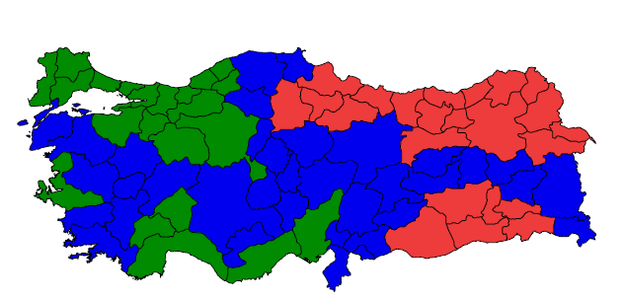
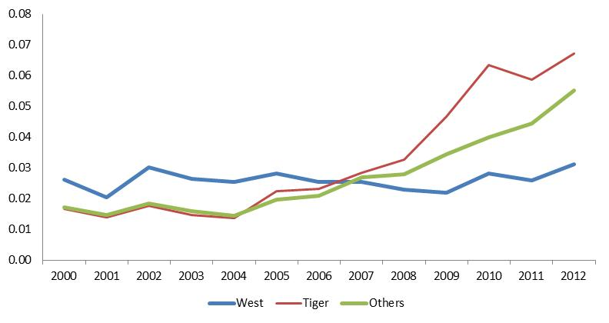
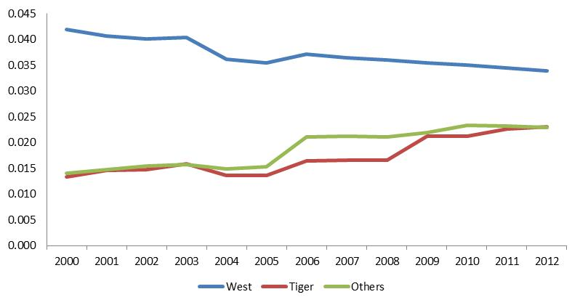
II.2 Turkey: Education & infrastructure boost innovation
Spending on education (per 000 population)
Spending on roadways (km per capita)
More rapid spending on integration, namely education (top) and roadways (bottom),
correlated with innovation (TFP), also output, exports and jobs catch-up of poorer region
Source: Atiyas, Bakis, Dutz and O’Connell (2014)

Slide 30
II.2 India: Public collaboration investments in biotech assets
Indian investment in global consortia - learning b/w Indian and foreign firms, public research organizations, universities… 15 countries including:
ISCB (Indo-Swiss Collaboration in Biotech), since 1974 +$33 mn public investment
agriculture: disease-resistant wheat, pest-resistant pulses
VAP (Indo-US Vaccine Action Program), since 1987 +$20 mn public investment
joint projects for major diseases in India
ex. Bharat Biotech rotavirus vaccine PDP in phase III trials (incl. IISc Bangalore, AIIMS, US NIH, Stanford, Atlanta CDC, PATH)
UK Welcome Trust R&D for Affordable Healthcare, since 2010 +£45 mn public inv.
translational research projects incl. therapeutics, vaccines, diagnostics
Other: Australia, Canada, Denmark, EU, Finland, Germany, Japan, Norway, Swe…

Slide 31
II.2 India: Use of Structured Research Protocols
Among others, investments in learning how to do:
common data sharing processes
commercializ.-driven milestone-based incentives
monitoring via joint review processes
escalation mechanisms for dispute resolution
Source: Dutz and Vijayaraghavan (2014)

Slide 32
II.2 Chile: Public collaboration investments in agri industry
Chile government-supported investments in connectivity & collaboration 05-10: learning from local & foreign firms, public research organizations, universities… including (USD 2012):
Global connectivity: $5.1 mn (InnovaChile; 40% private on ave exc PTIs), of which
34 “Misiones Tecnologicas” (study tours, e.g. to Bordeaux, Rioja)
15 “Consultorias Especializadas” (foreign specialized consultancies)
3 “Programas Territoriales Integrados” (diagnoses of regional deficiencies coupled with consultancies from foreign experts, 100% CORFO-financed)
Market research: $0.4 mn (InnovaChile; 40% private)
4 “Programas de prospección e investigación de mercados” (carried out by the wine associations and jointly shared with all members)
Marketing: $11.5 mn (CORFO; 47% private on ave), of which
21 “PROFOs” (strengthening jt marketing capabilities of collaborative SMEs)
18 collaborative local wine tourism regional development initiatives
4 collaborative export regional development initiatives (e.g. “for Asia”)
R&D: $41.8 mn (Innova, FIA, FONDECYT, FONTEC..; 31% private on ave.), of which
most are joint projects between universities or private res. cos. & groups of firms
2 are explicitly “Consorcios Tecnológicos Empresariales” (collaborative)
+ training & biz process improvement investments to strengthen absorptive capacity
($15.3 mn) ($1.1 mn)
Source: Dutz, O’Connell and Troncoso (2014)

Slide 33
II.2 Chile: Knowledge K and Wine Exports

